Slide 1

#LifeKoKaroLift
Android

Slide 2


Course : Android
Lecture On : Menus & Material Design
Instructor : Rohit Jain

Slide 3
In the last class we covered…
Grid View
Card Layouts
Floating Action Button

Slide 4
Today’s Agenda
Material Design
ToolBar & Menus
Dialog Box
Navigation Drawer
ViewPager

Slide 5
Material Design
The concrete highlights of a material-designed app would include the following elements:
Vibrant Color Schemes
Updated Iconography
RecyclerView for Lists with items as CardViews
Leveraging the new App Toolbar
Dynamic Scrolling Behavior with CoordinatorLayout
Floating Action Buttons for important actions
Ripple Animations for Touch Feedback
Shared Element Morph Transitions during navigation
View Elevation and Shadows
Updated Dialog Themes

Slide 6
Check List
Include Support Library
Design Support Library
Change the Application Theme
Extend Activities from AppCompatActivity
Use Support ActionBar
Material Design Icons
Material Navigation Drawer
Material Views
Toolbar
Floating Action Buttons
Material Animations

Slide 7
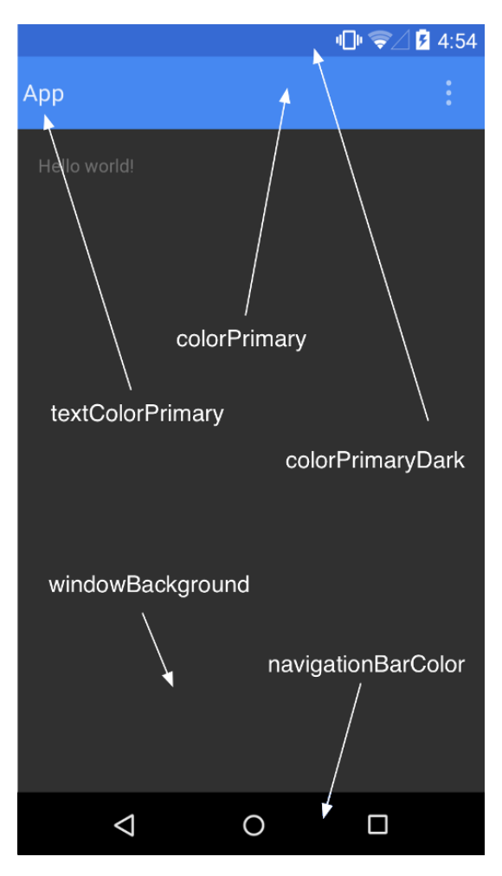
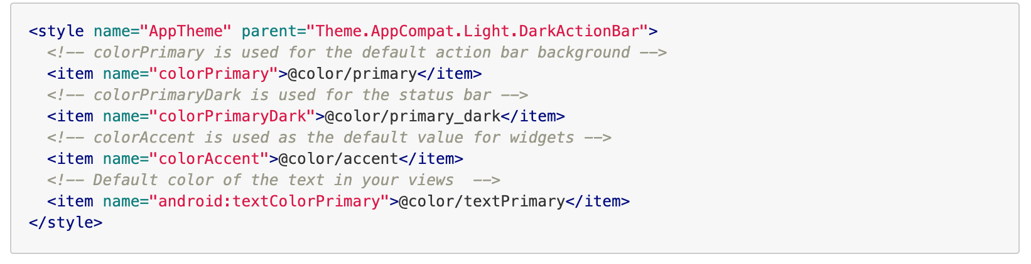
Theme

Slide 8
Menus
Apps often need to provide the user with a consistent experience for executing actions that are contextually specific. The most common actions for an activity live on the default Action Bar but actions that are more specific to an item or element can be displayed contextually using menus and popups.

Slide 9
ToolBar
Toolbar was introduced in Android Lollipop, API 21 release and is the spiritual successor of the ActionBar. It's a ViewGroup that can be placed anywhere in your XML layouts

Slide 10
ToolBar Vs ActionBar
The Toolbar is a generalization of the ActionBar system. The key differences that distinguish the Toolbar from the ActionBar include:
Toolbar is a View included in a layout like any other View
As a regular View, the toolbar is easier to position, animate and control
Multiple distinct Toolbar elements can be defined within a single activity
Keep in mind that you can also configure any Toolbar as an Activity’s ActionBar, meaning that your standard options menu actions will be display within.
Note that the ActionBar continues to work and if all you need is a static bar at the top that can host icons and a back button, then you can safely continue to use ActionBar.

Slide 11
Steps to add a toolbar and Menu
Change the default theme to NoActionBar
Add Toolbar in main_activity.xml
Override method onCreateOptionsMenu and setup actionbar in MainActivity.java
Add a res/menu/menu.xml file

Slide 12
Demo ToolBar

Slide 13
Dialog Box
DialogFragment is a specialized Fragment used when you want to display an overlay modal window within an activity that floats on top of the rest of the content.
This is typically used for displaying an alert dialog, a confirm dialog, or prompting the user for information within an overlay without having to switch to another Activity.

Slide 14
Steps
Create a custom View xml
Define the fragment
Setup Fragment in the activity

Slide 15
Demo Dialog Box

Slide 16
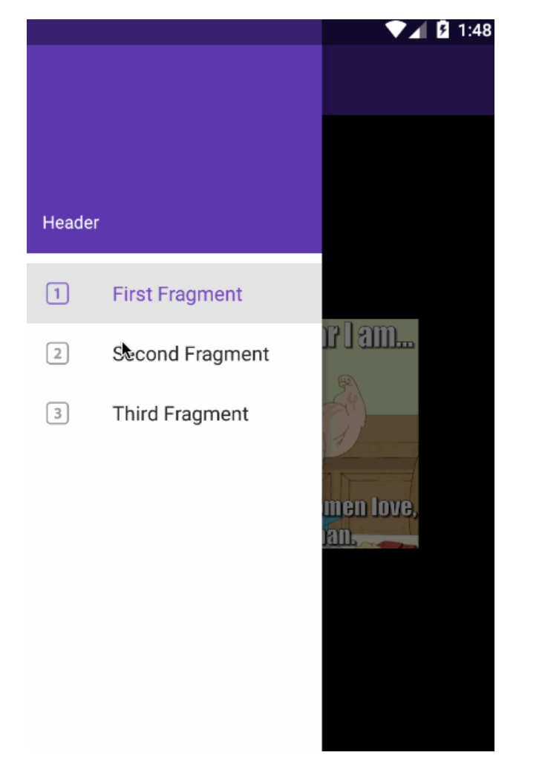
Navigation Drawer
With the release of Android 5.0 Lollipop, the new material design style navigation drawer spans the full height of the screen and is displayed over the ActionBar and overlaps the translucent StatusBar

Slide 17
Steps to implement Navigation Drawer
1. Add Dependencies
2.Setup Drawer Resource
3.Define Fragment
4.Setup ToolBar
5.Setup Drawer in Activity

Slide 18
Demo Navigation Drawer

Slide 19
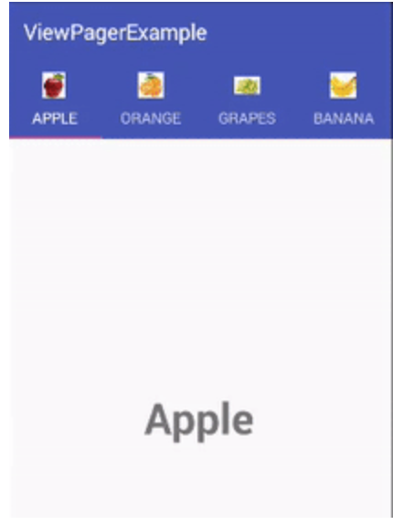
ViewPager
Layout that allows the user to swipe left and right through "pages" of content which are usually different fragments. This is a common navigation mode

Slide 20
Building a Whatsapp Viewpager
Add a TabLayout
Add a ViewPager
Define Fragments

Slide 21
Demo ViewPager

Slide 22
#LifeKoKaroLift
Thank You!

